Slide 1
The role of ICT in the Management of Secondary Schools in Uganda
Uganda Secondary Education Expansion Project (USEEP)

Slide 2
ICT – The Game changer in School Management
ICT – Information and Communication Technology
Very useful tool for operational efficiency – faster, more accurate, more consistent
Data driven decision-making eliminates biases and errors
Improved communication
Revolutionised by Internet connectivity – Instant global access and global reach
Users swept by Social Media wave – Opt out, lose out!
Artificial Intelligence trends offer opportunities and challenges

Slide 3
Administration and data management
Various administrative tasks can be automated, making the work more accurate and simpler e.g.
Attendance tracking
School fees management and tracking
Time-table scheduling
Inventory management
storage and management of large volumes of data (e.g. student records, staff details, and academic performance) for easy access to accurate and up-to-date information
Consider using cloud-storage facilities for reliable access to data

Slide 4
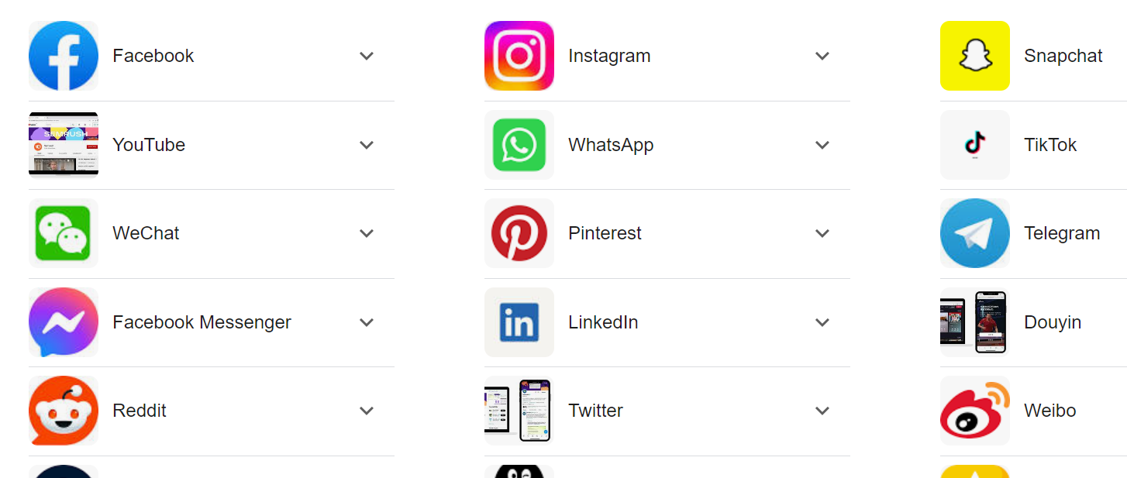
Visibility, branding and marketing
Online presence through school website and social media platforms improves visibility and sets school brand
Digital marketing possible using social media platforms
Opportunity to market school and its auxiliary business ventures

Slide 5
Financial Management
Online payment systems like School pay make it easier to monitor and manage school fees payments
Budgeting and Accounting: ICT tools assist in managing school budgets, tracking expenses, and generating financial reports; making financial management more transparent and efficient.
Consider acquiring specialized school financial management software
Beware of high risk of fraud in online transactions – seek professional information security support and keep parents and other stakeholders alerted.
Discussion point: Share experiences of those using financial management software and challenges of those not yet using

Slide 6
Communication
Improved communication between school management, teachers, students, parents and other stakeholders
Faster and more efficient communication through e-mails, SMS messaging and SM channels and messaging apps, especially WhatsApp
ICT completes the communication cycle by providing for 2-way communication either in real time (synchronous) or at varied times (asynchronous)
Improved customer care and relationship management through ticketing systems
Important to have a formal house communication style for consistency and trust

Slide 7
Decision Making
Improved decision-making through Data-Driven Decisions:
With ICT, school management can analyze data on student performance, staff performance, resource allocation, and other key metrics to make informed decisions for better educational outcomes and more efficient use of resources.
Effective Monitoring and Reporting:
ICT enables the real-time monitoring of various aspects of school operations, allowing for timely interventions and reporting to relevant stakeholders.

Slide 8
Academic Management
Curriculum Planning and Implementation:
Use of electronic templates for schemes of work, lesson planning, and lesson delivery promotes standardization and efficiency.
Assessment and Evaluation:
Online assessment tools and learning management systems (LMS) allow for easy creation, distribution, and grading of exams and assignments; providing instant feedback to students and teachers.
Automated report card systems ensure accurate and fast preparation of end-of-term report cards

Slide 9
Security and safety
Improved security of school facilities and personnel through surveillance cameras (CCTV) and access control systems
Improved privacy of personal information through data encryption and user authentication procedures
Instant sharing of access information with concerned parties for ease of tracking e.g. SMS instantly sent to parents (for day-schoolers) notifying time of arrival or departure from school

Slide 10
Professional Development
Online platforms for continuous professional development of teachers and other staff through online courses, webinars, and other e-learning resources e.g. Udemy, YouTube, Coursera etc
Online workshops can be conducted for teachers via video-conferencing software like Zoom or Google Meet making professional development more affordable and flexible

Slide 11
Conclusion
The ICT revolution in educational management is already with us, we either adjust to it and reap its benefits or be swept to the garbage heap of history!

